Slide 1
CUSTOMER SHOPPING BEHAVIOR
ANALYSIS
Turning 3,900 transactions into revenue, retention & discount strategy
PYTHON • SQL • POWER BI
3,900 Customer Records | August 2026

Slide 2





AGENDA
What We'll Cover
Project Overview & Methodology
01
How the analysis moved from raw data to a live dashboard.
Dataset & Exploratory Analysis
02
3,900 transactions, cleaned and profiled in Python.
SQL Analysis — 10 Business Questions
03
Revenue, discounts, loyalty, products, and demographics.
Power BI Dashboard
04
An interactive view for ongoing monitoring.
Business Recommendations
05
Six concrete next steps for the business.
2

Slide 3

PROJECT OVERVIEW
From Raw Data to Decisions
3,900 retail transactions were cleaned and explored in Python, mined with ten targeted SQL queries, and consolidated into a live Power BI dashboard for ongoing monitoring.
→
→
Clean & Explore
Answer 10 Questions
Visualize & Monitor
Python — Pandas & NumPy
SQL Queries
Power BI Dashboard
INSIGHT Each stage fed the next — EDA shaped the SQL questions; SQL results populate the dashboard.
3

Slide 4
DATASET SUMMARY
Dataset at a Glance
3,900
18
4
$59.76
3.75 / 5
Customer Records
Data Fields
Product Categories
Avg. Order Value
Avg. Review Rating
Source: customer_shopping_behavior.csv — demographics, item purchased, transaction value, and shopping behavior flags (discounts, subscriptions, shipping, review ratings).
INSIGHT Only Review Rating has missing values — 37 records (0.9%) — safely ignored by SQL's AVG().
4

Slide 5
EXPLORATORY DATA ANALYSIS
Who's Shopping, What They Buy
Customers by Gender
Orders by Category (%)
INSIGHT Clothing and Accessories alone account for more than three-quarters of all orders (76.3%).
5

Slide 6
SQL ANALYSIS — Q1
Revenue Concentration by Category
Revenue by Gender
$157,890
$75,191
Male (68% of customers)
Female (32% of customers)
Avg. order value: $59.54 (Male) vs. $60.25 (Female)
INSIGHT Revenue share mirrors customer share — gender has almost no effect on individual spend.
6

Slide 7
SQL ANALYSIS — Q2 & Q6
Discounting: Broad Reach, Uneven Payoff
Top 5 Most-Discounted Products
43%
of all orders used a discount
50%
of discount users still spent above average ($79.79 avg.)
INSIGHT Discounts aren't limited to price-sensitive shoppers — half were already big spenders.
7

Slide 8
SQL ANALYSIS — Q3 & Q8
Product Performance: Ratings & Bestsellers
Top 5 Rated Products
#1 Seller in Each Category
Gloves
★ 3.86
Accessories
171 orders
Jewelry
Sandals
★ 3.84
Clothing
171 orders
Boots
★ 3.82
Blouse
Hat
★ 3.80
Footwear
160 orders
Sandals
Skirt
★ 3.79
Outerwear
163 orders
Jacket
INSIGHT Ratings and order counts are both tightly clustered — demand and satisfaction are broad, not concentrated in one hit product.
8

Slide 9
SQL ANALYSIS — Q4, Q5 & Q9
Shipping & Subscription Behavior
$60 vs $58
$59.49 vs $59.87
27%
91% vs 88%
Avg. order: Express vs. Standard shipping
Avg. spend: Subscribers vs. non-subscribers
of customers hold an active subscription
Repeat-buyer rate: subscribers vs. non-subscribers
INSIGHT None of these gaps are large — shipping speed, subscription, and loyalty barely move average spend.
9

Slide 10
SQL ANALYSIS — Q7
Customer Segments: New, Returning & Loyal
79.9%
of customers are already Loyal (10+ previous purchases)
2.1%
of customers are New (just 1 previous purchase)
18.0%
of customers are Returning (2-10 previous purchases)
INSIGHT Retention is strong and acquisition is thin — the funnel depends on a small trickle of new customers.
10

Slide 11
SQL ANALYSIS — Q10
Revenue Contribution by Age Group
INSIGHT Revenue tracks how many customers are in each age band, not how much any one of them spends.
11

Slide 12
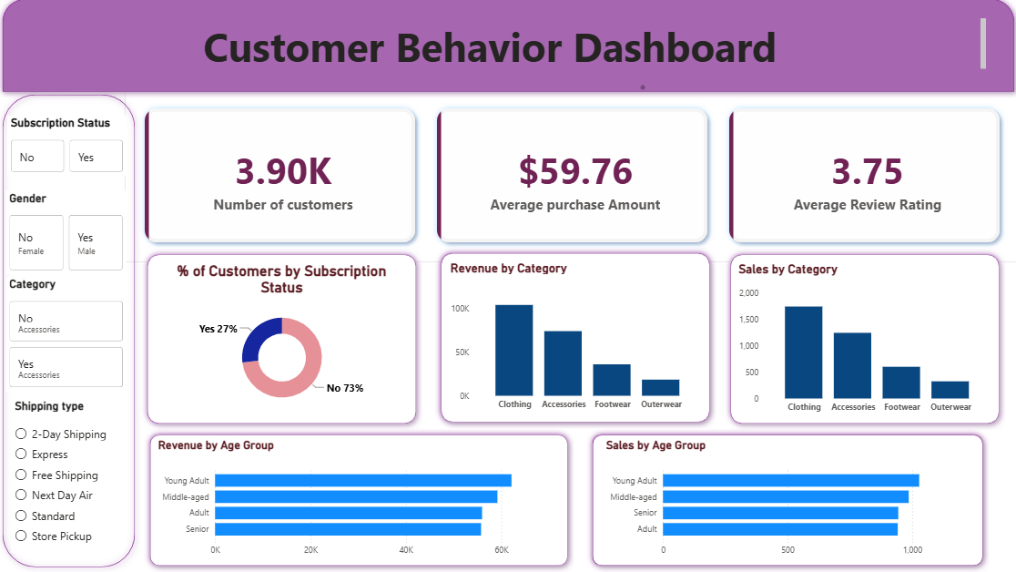
POWER BI DASHBOARD
Customer Behavior Dashboard
KPI cards, category & age-group breakdowns, and live slicers for subscription, gender, category, and shipping type.
12

Slide 13






RECOMMENDATIONS
Six Ways to Act on These Findings
Grow acquisition
Re-think subscription perks
Only 2% of customers are new — the loyalty engine already works once they arrive.
Subscribers don't spend more per order — add spend-based incentives, not just access.
Target discounts more precisely
Watch margins on key items
Half of discount users were already big spenders — reserve discounts for new or lapsing customers.
Hats, Sneakers, and Coats are discounted on nearly half of all orders.
Keep Clothing & Accessories central
Review the dashboard on a cadence
They lead both order volume and revenue.
Track revenue, discount rate, and segment mix as new data arrives.
13

Slide 14
Thank You
Questions & Discussion
Customer Shopping Behavior Analysis • Python · SQL · Power BI

